Slide 1
Role Based Allocation of WorkItems

Slide 2
What we:
Can do
Allocate a WorkItem to a single user in Process Designer
Want to do
Be able to allocate WorkItems to:
Have done
Allocation Config has been enhanced to allow allocating WorkItems to roles in the system (these roles can have any number of users)
A role in the Web Platform which consists of any number of users

Slide 3
Let’s see what we have done

Slide 4
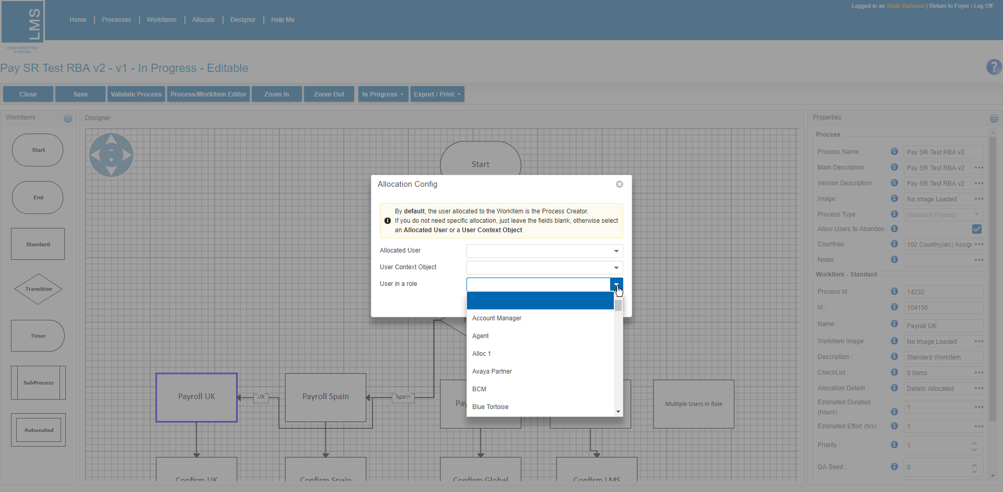
Process Designer allows you to allocate a WorkItem to a role
In the Allocation Config there’s a new option to Allocate to ‘User in a role’
Just select the relevant role from the list

Slide 5
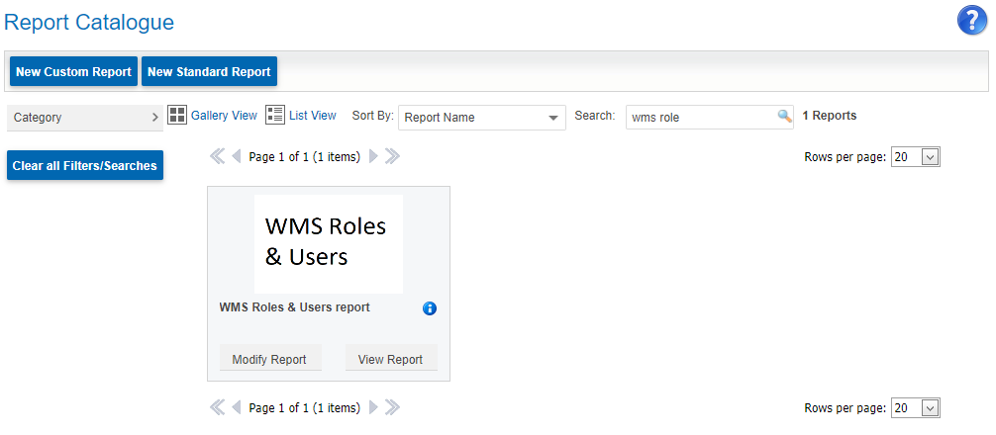
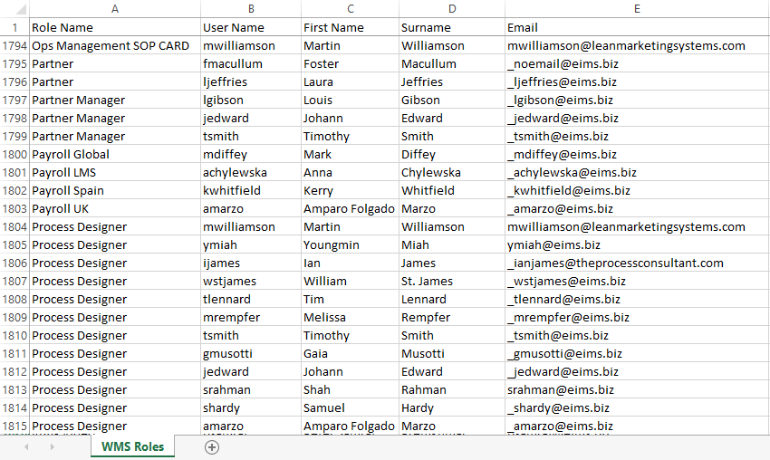
Things you need to know…
The roles in the dropdown list are setup by Support or by the Web Platform Administrator
Speak to Product Support copying in Sam Hardy if you require a role to be setup or users changed in a role
There is a new report on the Web Platform called ‘WMS Roles & Users report’ which displays all the active WMS Roles in the system and the users assigned to them
When allocating a WorkItem to a role with multiple users, the system will allocate the WorkItem to the first user in the role. All users in the role will see the WorkItem in their WorkItem List and be able to complete the WorkItem
When you change the user(s) in a role, the change will be visible the next time a new process instance is started (system does not retro allocate active process WorkItems).
E.g. If you change the user in the role ‘Office Manager UK’ from Julie to Danielle, the change will come into effect when the next process instance is started.
All existing Active/Inactive WorkItems which are allocated to the role ‘Office Manager UK’ will still be allocated to Julie
Next Action: will be to re-allocate the WorkItems to the new person in charge (who replaced Julie in the role = Danielle)

Slide 6
Scenario: Allocating a WorkItem to a role with a single user

Slide 7
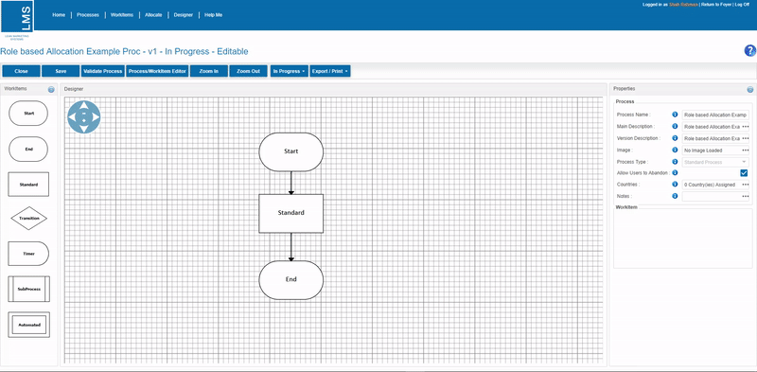
Example: Allocating a WorkItem to a role which contains a single user
In the WMS role report we can see that Amparo is the only user in the role ‘Payroll UK’
In designer click on the Standard WorkItem you want to allocate to this role
Click on the Allocation Details Ellipsis
Select role in the ‘User in a role’ list
‘Payroll UK’
Save Changes
The WorkItem has now been allocated to this role
This means that this WorkItem will be allocated to Amparo Folgado Marzo (who is the single person in this role).

Slide 8
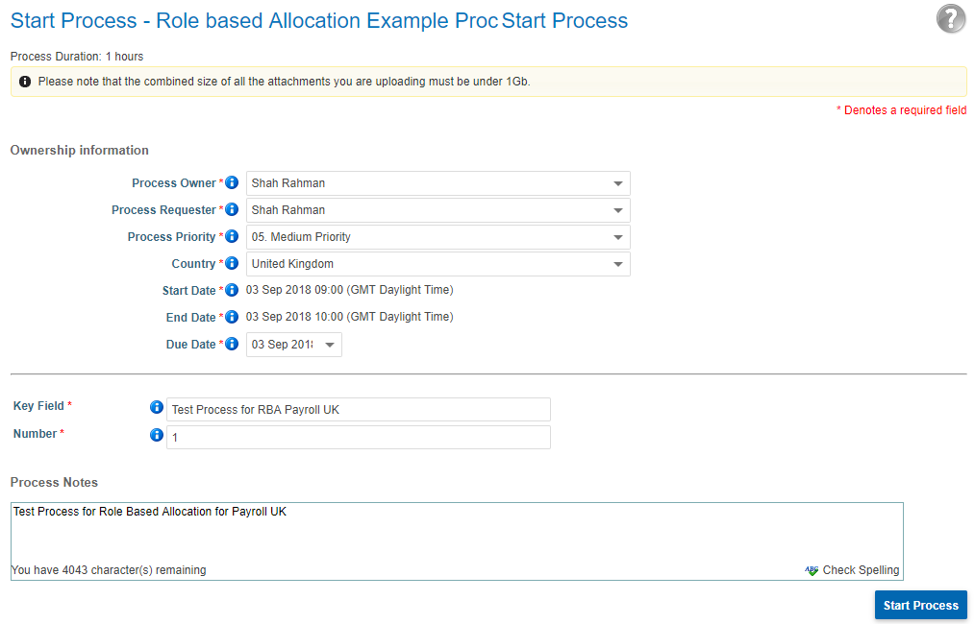
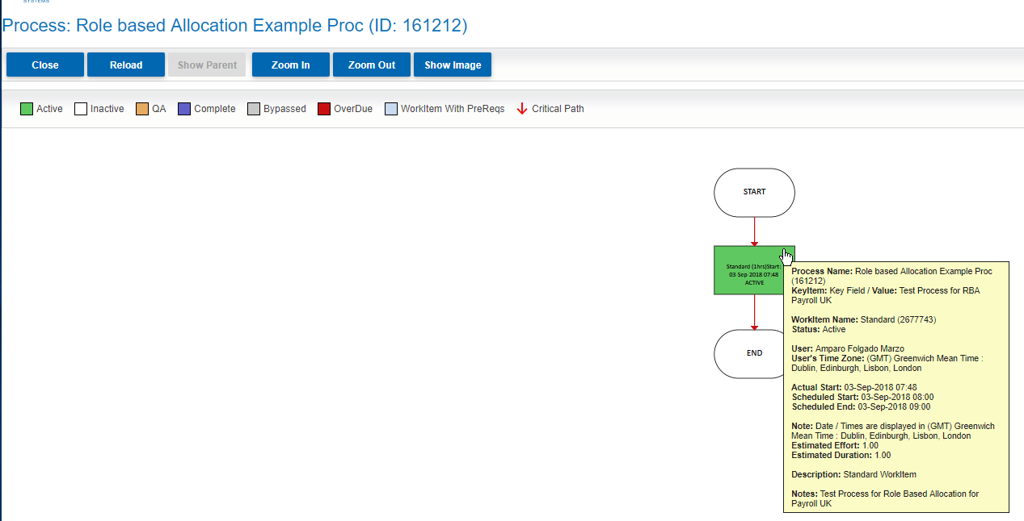
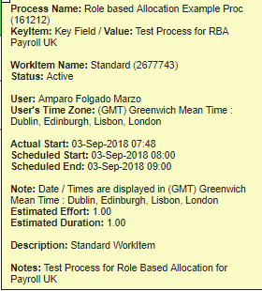
Cont… Now lets check the role allocation works…
Validate and Cut Live the process
Go to Start Process in WMS or Storefront Catalog Page and start the process
When the WorkItem activates, the WorkItem is allocated to Amparo and will be visible in Amparo’s WorkItem List
The WorkItem is visible in Amparo’s WorkItem List

Slide 9
Scenario: Allocating a WorkItem to a role with multiple users

Slide 10
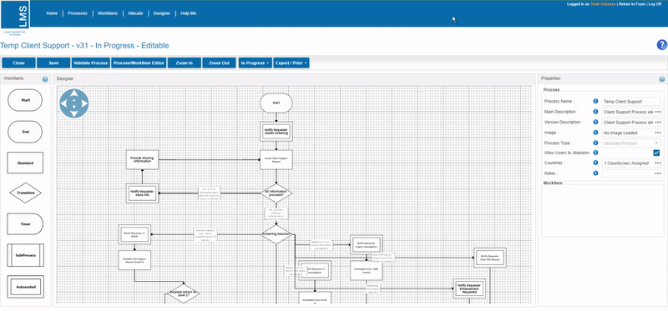
Example: Allocating a WorkItem to a role which contains more than one user
In the WMS role report we can see that David and Youngmin are the users in the role ‘LMS Support’
In designer click on the Standard WorkItem you want to allocate to this role
Click on the Allocation Details Ellipsis
Select role in the ‘User in a role’ list
‘LMS Support’
Save Changes
The WorkItem has now been allocated to this role
This means that this WorkItem will always be allocated to the first user listed for this role: David Deaves
Other user(s) in the role will see the WorkItem & be able to complete it. In this case the other user is Youngmin who has Full Access to the WorkItem.
`

Slide 11
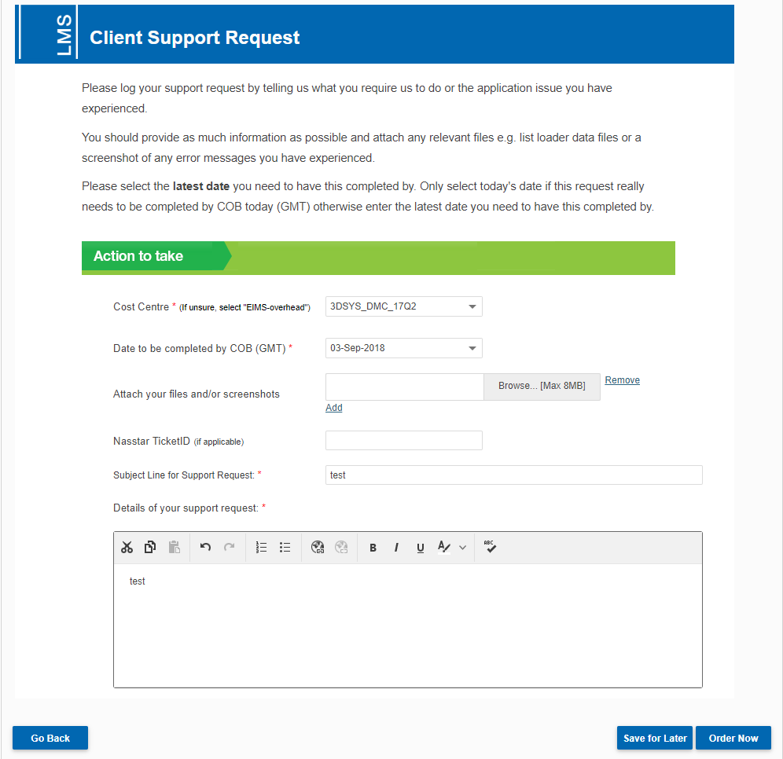
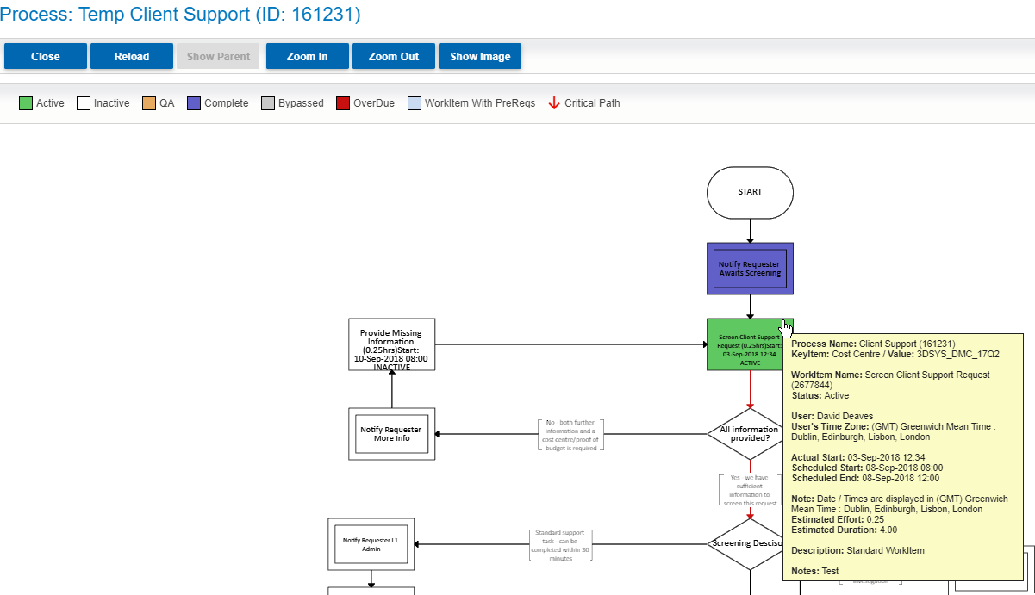
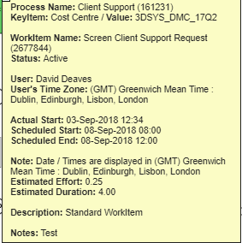
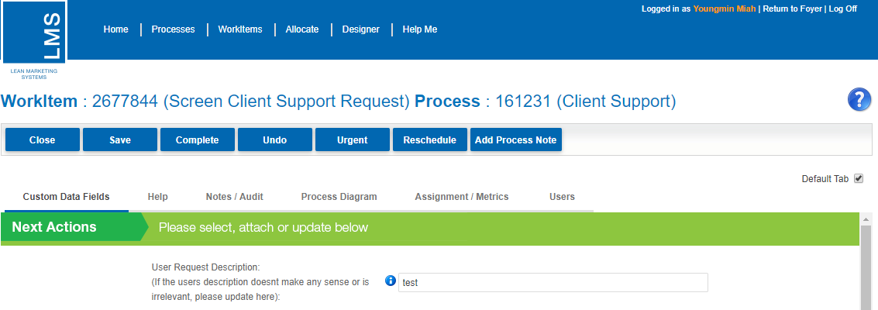
Cont…Now lets check the role allocation works correctly…
Validate and Cut Live the process
Go to Start Process in WMS or Storefront Catalog Page and start the process
When the relevant WorkItem activates, it will be allocated to the first user in the role and also appear in all users WorkItem Lists.
So the WorkItem will be allocated to David and also appear in Youngmin’s WorkItem List
WorkItem is allocated to the first user in the role
The WorkItem is visible in Youngmin’s WorkItem List too
Youngmin is also able to complete the WorkItem

Slide 12
Scenario: Taking ownership of the WorkItem

Slide 13
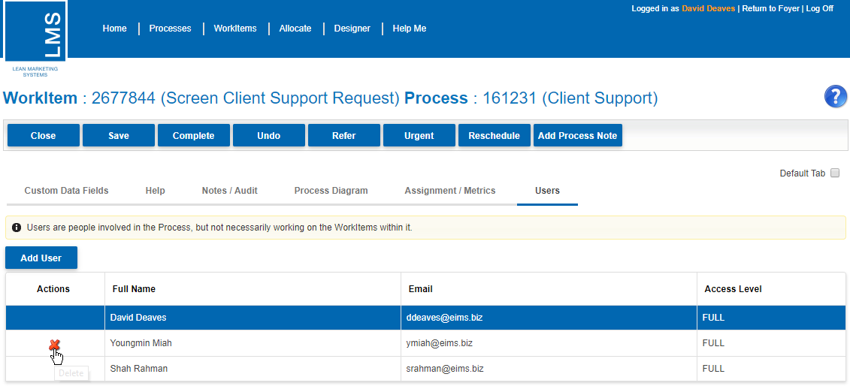
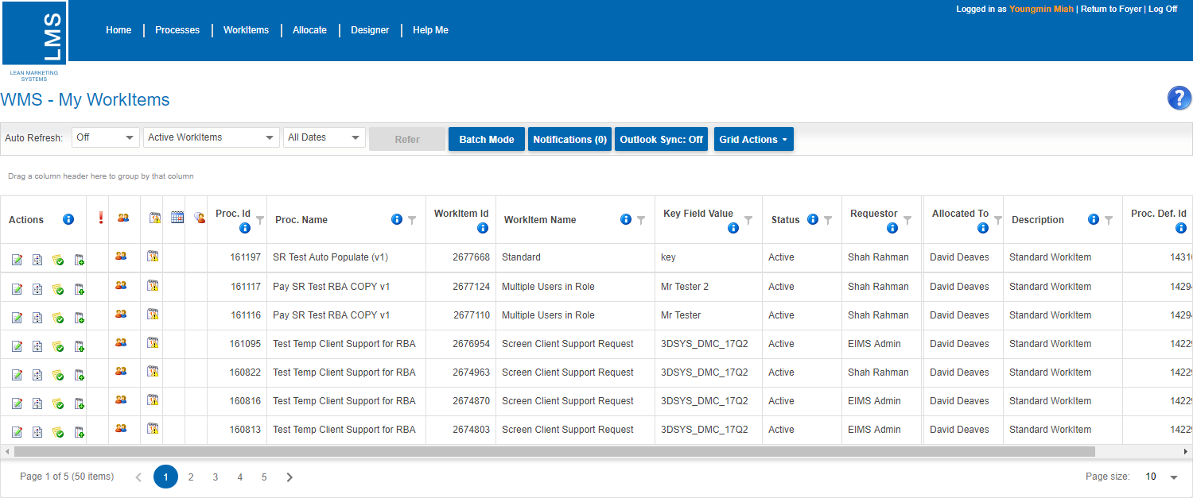
Example: Taking ownership of a WorkItem
To take ownership of a WorkItem, the allocated user needs to remove all other users from the WorkItem
Go to the WorkItem Details and remove the other users
In this example we are going to remove/delete Youngmin from the WorkItem
Youngmin has now been removed/deleted from the WorkItem
Now that we have removed/deleted Youngmin from the WorkItem, she can no longer see the WorkItem in her WorkItem List
Only David will see and be able to complete the WorkItem from here onwards
Youngmin is no longer in the list of users anymore
The WorkItem is not visible in Youngmin’s WorkItem List anymore

Slide 14
Scenario: What happens when you change the single user in a role

Slide 15
Changing the single user in a role and checking the allocation for new instances of processes
We have changed the single user in role ‘Payroll Global’ from Anna Fordham to Mark Diffey
Any existing WorkItems in the system which are allocated to ‘Payroll Global’ will be allocated to Anna Fordham
Any new process instances with WorkItems allocated to ‘Payroll Global’ will be allocated to Mark Diffey
This process was instanced before the change was made to the user in the role ‘Payroll Global’
Before
Before
Now
This process was instanced after the change was made to the user in the role ‘Payroll Global’
New instance for above process
Now

Slide 16
Thank you for your time! END

