Slide 1
Calculated Data Fields Improvement

Slide 2
What we set out to do
For the current "Calculated Data" field to accept formatting information using standard formatting (Standard Numeric Format Strings):
https://msdn.microsoft.com/en-us/library/427bttx3.aspx
The data will be displayed in all forms according to the entered formatting information
Especially %
If no formatting information is present, the default (present) format is used
Note: Formatting applies to the display to users, not the underlying data in the field. So for reporting purposes, the value in the cell will be unchanged. Thus reporting is unaffected by this new functionality☺

Slide 3
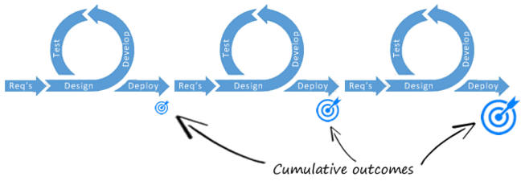
What we need to remember for new functionality…
Product is in line with original requirements
Waterfall
(Plan driven)
Requirements collected & agreed upon at intervals (FY or QTR) = fixed
Agile
(Value driven)
Natural Evolution: Requirements Change
If you want this functionality for a process you will need to add it!
Technology Evolution: Enhanced functionality made available to users
Product is responsive to changing needs in the organisation
II
Increments of value
Notes:
Agile vs Waterfall

Slide 4
How to use Calculated Data Standard Formats

Slide 5
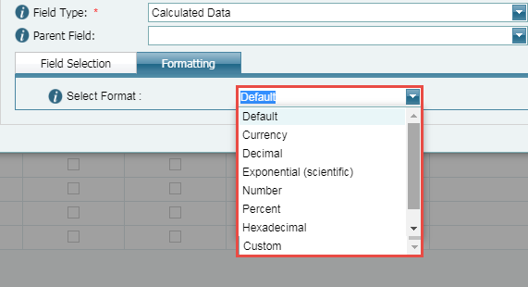
New Formatting tab for field type = Calculated Data
If you choose to apply a format to your calculated data value, these are the selectable options:
In the next few slides we’ll be going through all options….
For all standard formats no further input is required from the user

Slide 6
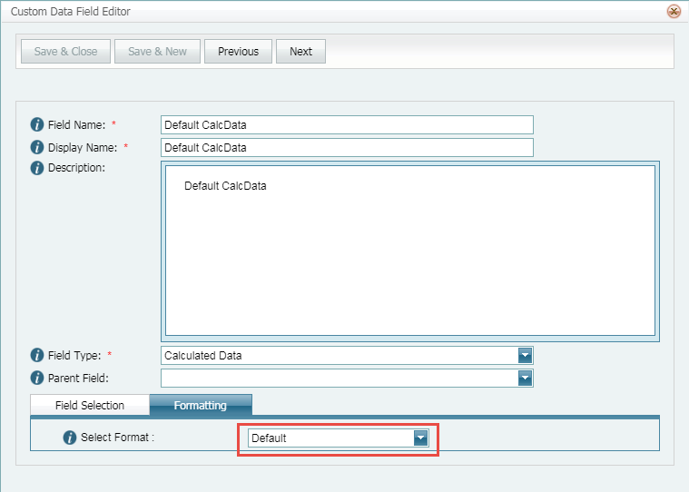
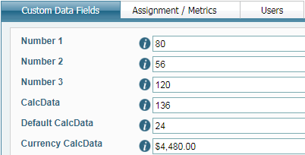
What to expect for Default format
Applies if Default is selected for formatting or if left blank
Default format will display the same as the source field configuration
i.e. The exact result of the calculation (without any symbol or placers)
Set Up in Designer:
How the user will see it:
Configuration in Designer & value in field:
Number 1 – Number 2
80 - 56 = 24
9 – 12 = -3
20 – (-4) = 24
Example 1
Example 2
Example 3
Or left blank

Slide 7
What to expect for Currency format
A currency value as per the set up
i.e. The exact result of the calculation using current culture* symbol = $
Set Up in Designer:
Standard numeric format string:
How the user will see it:
Configuration in Designer & value in field: Number 1 * Number 2
80 x 56 = 4480
9 x 12 = 108
20 x (-4) = -80
So, at the moment all currency calculation format will be $
Example 1
Example 2
Example 3
* EIMS webserver setting is US culture (Azure)
* LMS have an enhancement user story to customise the Currency symbol when the format is selected (this will be done in the next release)

Slide 8
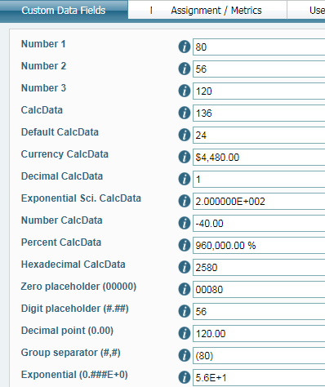
What to expect for Number format
Integral and decimal digits, group separators, and a decimal separator with optional negative sign
i.e. Standard Number = number with 2 decimal spaces
Set Up in Designer:
Standard numeric format string:
How the user will see it:
Configuration in Designer & value in field : Number 1 - Number 3
80 - 120 = -40
20 - 3.75 = 16.25
-20 - 16.25 = -36.25
Example 1
Example 2
Example 3

Slide 9
What to expect for Percent format
Number multiplied by 100 and displayed with a percent symbol
i.e. Standard Percent always rounded to 2 decimal places
Set Up in Designer:
Standard numeric format string:
How the user will see it:
Configuration in Designer & value in field : Number 1 * Number 3
(80 x 120) x 100 = 960000
(20 x 3.75) x 100 = 7500
-20 x 16.25 = -32500
Example 1
Example 2
Example 3
See next slide!

Slide 10
Example for Percent Format

Slide 11
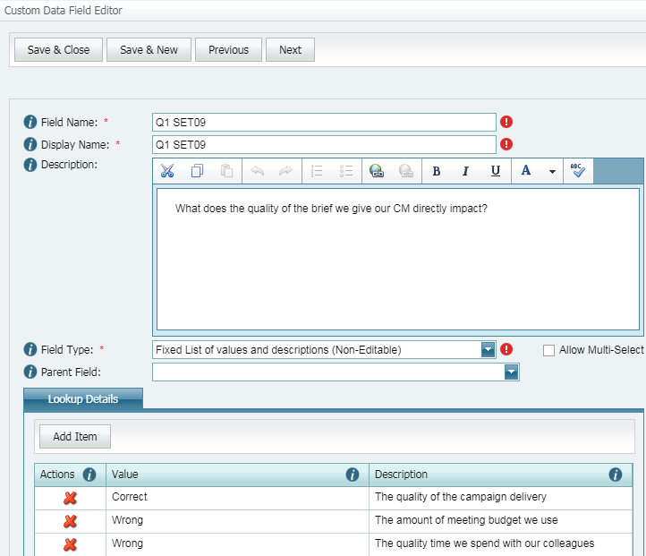
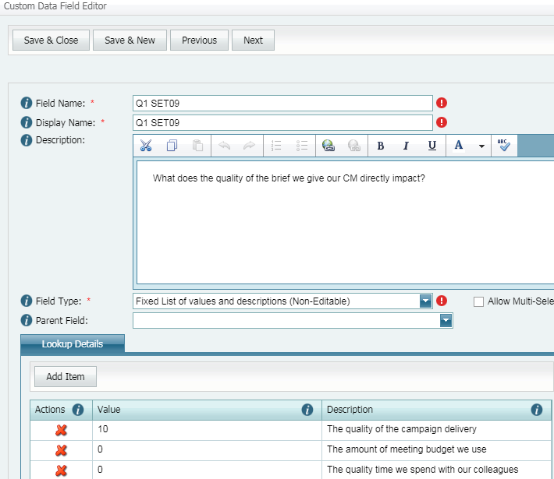
How to use the percent format correctly
If you want to display a calculation as if you were doing it on a calculator, all you need to do is format the final calculation to be displayed in format = Percent
Here’s an example of how this new functionality will work for eLearning processes
Step 1: Modify Fixed list of values & descriptions to have the score in value column
Repeat the action for all similar context objects in the process

Slide 12
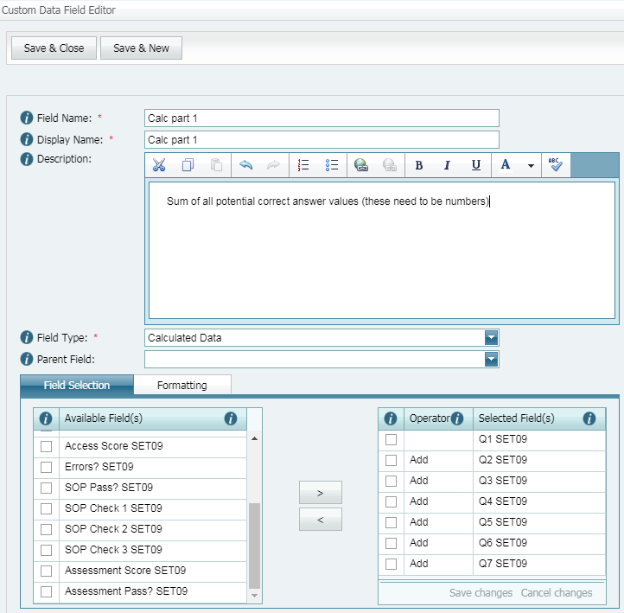
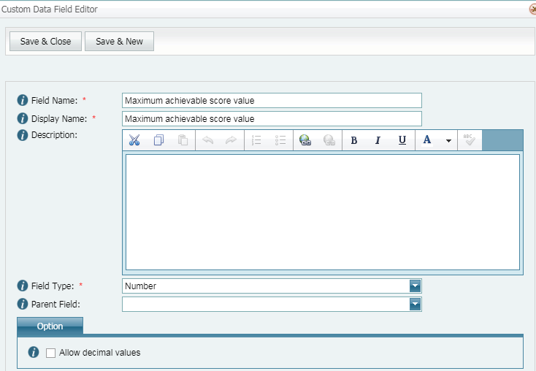
eLearning process example set up (cont)
Step 2: Add calculation for all scores achieved (in this example there are 7 questions, so add all fields)
Do not apply Formatting
Step 3: Add new number context object for maximum achievable score value (for 100% achievement)

Slide 13
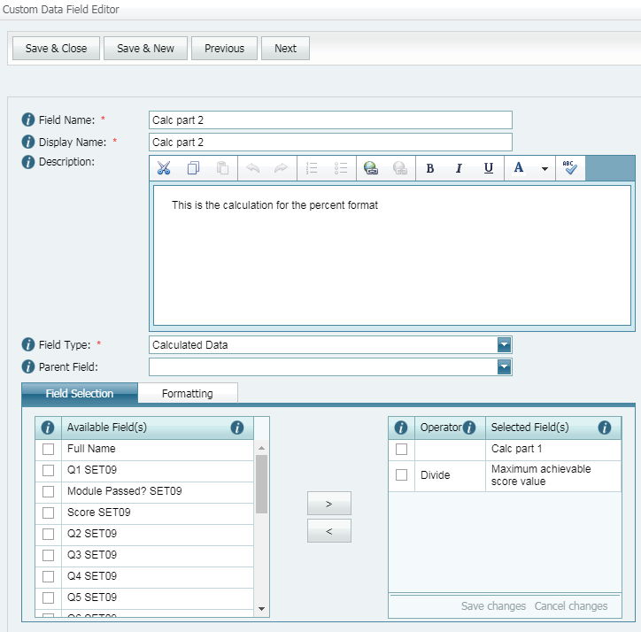
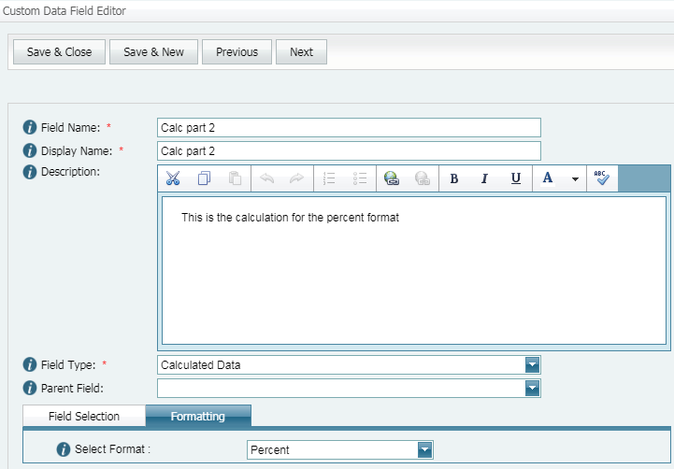
eLearning process example set up (cont)
Select Formatting = Percent
Step 4: Add the second calculation
Achieved / Maximum achievable

Slide 14
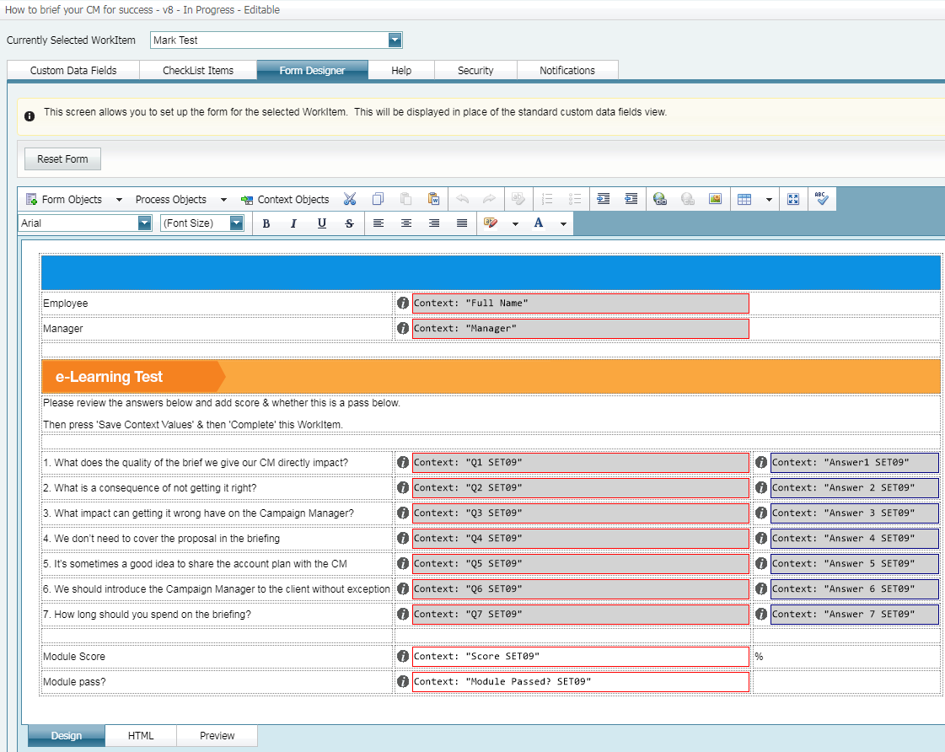
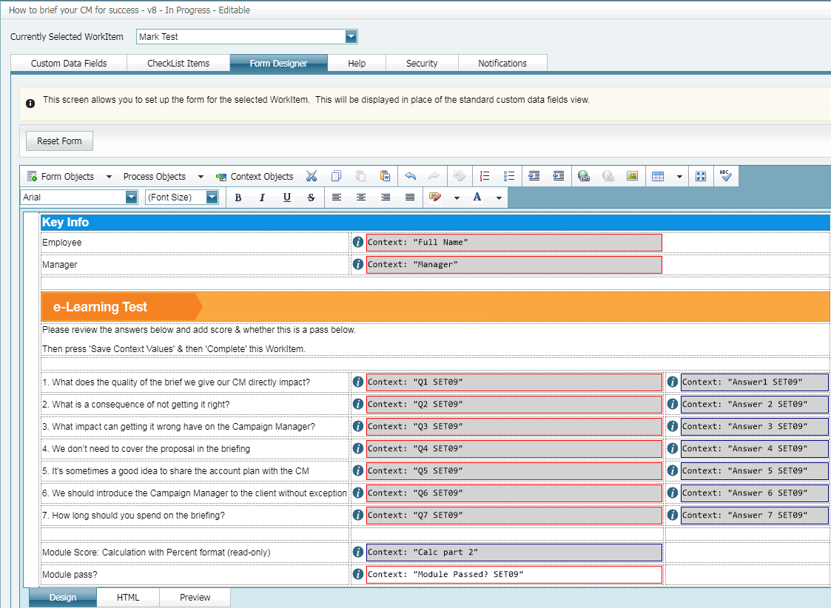
eLearning process example set up (cont)
Step 5: Update forms
Before and after example
Final calculation is read-only for ‘Mark Test’ WorkItem

Slide 15
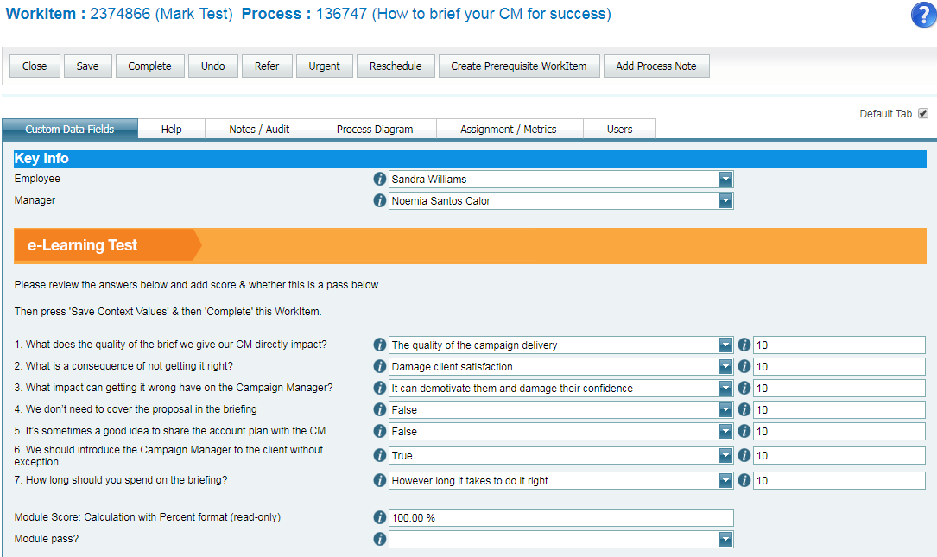
This is what the user will experience
Instead of correct/wrong answers, the user marking the test will see the number of points achieved for each answer
As the module score is a calculation it will be read-only
by having this done automatically we eliminate human error☺
* LMS have an enhancement user story so that in the set up of the calculated data context object the user needs to be able to enter a static number (this will be done in the next release)

Slide 16
Other Standard Formats (these do not require any extra input from the user)

Slide 17
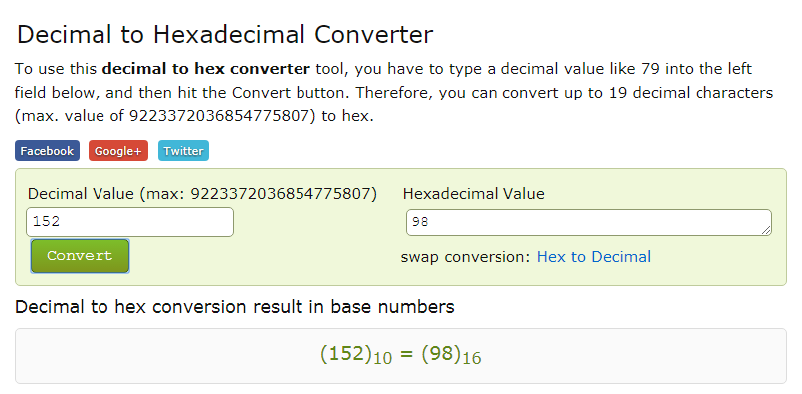
What to expect for Hexadecimal format
A hexadecimal string for Integral types only (integers)
Where to check hexadecimal conversions:
http://www.binaryhexconverter.com/decimal-to-hex-converter

Slide 18
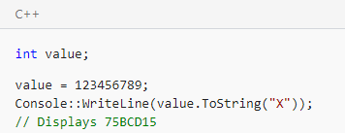
What to expect for Hexadecimal format (cont)
A hexadecimal string for Integral types only (integers)
Where to check hexadecimal conversions:
http://www.binaryhexconverter.com/decimal-to-hex-converter
Set Up in Designer:
Standard numeric format string:
How the user will see it:
Configuration in Designer & value in field:
Number 1 x Number 3
80 x 120 = 9600
20 x 3.75 = 75
-20 x 16.25 = -325
Example 1
Example 2
Example 3

Slide 19
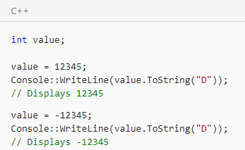
What to expect for Decimal format
Integer digits with optional negative sign
i.e. The result of the calculation narrowed down to the integer digit only
Set Up in Designer:
Standard numeric format string:
How the user will see it:
Configuration in Designer & value in field: Number 1 / Number 2
80 / 56 = 1.6
9 /12= 0.75
20 / (-4) = -5
Example 1
Example 2
Example 3
Integer digit
Integer

Slide 20
What to expect for Exponential (scientific) format
Exponential notation
i.e. The result of the calculation narrowed down to the integer digit only
Set Up in Designer:
Standard numeric format string:
How the user will see it:
Configuration in Designer & value in field: Number 1 + Number 3
80 + 120 = 200
20 + 3.75 = 23.75
-20 + 16.25 = -3.75
Example 1
Example 2
Example 3

Slide 21
This section covers Custom formats

Slide 22
In Formatting tab for field type = Calculated Data
You choose to apply a ‘Custom’ format to your calculated data value, a new field will load where you can add the string you want to use:
The string detail will be listed in C++ in https://docs.microsoft.com/en-us/dotnet/standard/base-types/custom-numeric-format-strings#SpecifierTh
In the next few slides we’ll be going through all options….
If this is the display format you want, then all you need to do is paste the value.ToString in the double quote marks into the ‘Custom Format’ field

Slide 23
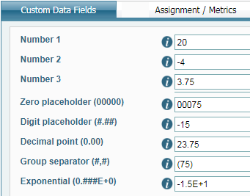
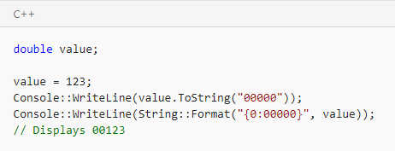
What to expect for Zero placeholder format
Replaces the zero with the corresponding digit if one is present; otherwise, zero appears in the result string.
To five digits
Set Up in Designer:
You will need to add the value.ToString in the ‘Custom Format’ field:
How the user will see it:
This is the cell value (reportable value)
Configuration in Designer & value in field: Number 1 x Number 3
20 x 3.75 = 75
-20 x 16.25 = -325
80 x 120 = 9600
Example 1
Example 2
Example 3

Slide 24
What to expect for Digit placeholder format
Replaces the "#" symbol with the corresponding digit if one is present; otherwise, no digit appears in the result string.
Note that no digit appears in the result string if the corresponding digit in the input string is a non-significant 0. For example, 0003 ("####") -> 3.
Set Up in Designer:
You will need to add the value.ToString in the ‘Custom Format’ field:
How the user will see it:
Configuration in Designer & value in field: Number 2 x Number 3
-4 x 3.75 = -15
55.3 x 16.25 = 898.625
56 x 120 = 6720
Example 1
Example 2
Example 3

Slide 25
What to expect for Decimal point format
Determines the location of the decimal separator in the result string.
Set Up in Designer:
You will need to add the value.ToString in the ‘Custom Format’ field:
How the user will see it:
Configuration in Designer & value in field: Number 1 + Number 3
20 + 3.75 = 23.75
-20 + 16.25 = -3.75
80 + 120 = 200
Example 1
Example 2
Example 3

Slide 26
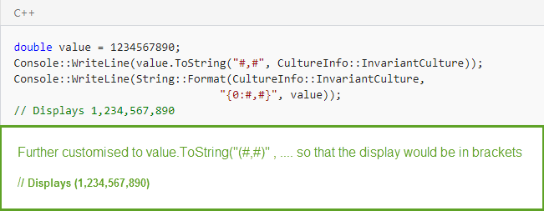
What to expect for Group Separator format
Serves as both a group separator and a number scaling specifier. As a group separator, it inserts a localized group separator character between each group. As a number scaling specifier, it divides a number by 1000 for each comma specified.
Set Up in Designer:
You will need to add the value.ToString in the ‘Custom Format’ field:
How the user will see it:
Configuration in Designer & value in field: Number 1 x Number 3
20 x 3.75 = 75
-20 x 16.25 = -325
80 x 120 = 9600
Example 1
Example 2
Example 3

Slide 27
What to expect for Exponential notation format
If followed by at least one 0 (zero), formats the result using exponential notation. The case of "E" or "e" indicates the case of the exponent symbol in the result string. The number of zeros following the "E" or "e" character determines the minimum number of digits in the exponent. A plus sign (+) indicates that a sign character always precedes the exponent. A minus sign (-) indicates that a sign character precedes only negative exponents.
Set Up in Designer:
You will need to add the value.ToString in the ‘Custom Format’ field:
How the user will see it:
Configuration in Designer & value in field: Number 2 x Number 3
-4 x 3.75 = -15
55.3 x 16.25 = 898.625
56 x 120 = 6720
Example 1
Example 2
Example 3

Slide 28
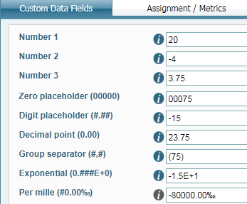
What to expect for Per Mille format
Multiplies a number by 1000 and inserts a localized per mille symbol in the result string.
Set Up in Designer:
You will need to add the value.ToString in the ‘Custom Format’ field:
How the user will see it:
Configuration in Designer & value in field: Number 1 x Number 2
20 x (-4) = -80
-20 x 55.3 = -1106
80 x 56 = 4480
Example 1
Example 2
Example 3
Also easy to find in the example section of the page

Slide 29
END Thank-you for your time!

