Slide 1
Animated Process Flows

Slide 2
What we wanted to do
In Overview make it clear to the user (via animation) all the updates which are happening in a Process
WorkItem summaries/statistics need to update when viewing a process in overview mode
What we have done
Users can see the progress of WorkItems in a process with real time animation when WorkItems have been completed.
This means that we can clearly see what is happening at any point in time for a process

Slide 3
Where you will access animated process flows

Slide 4
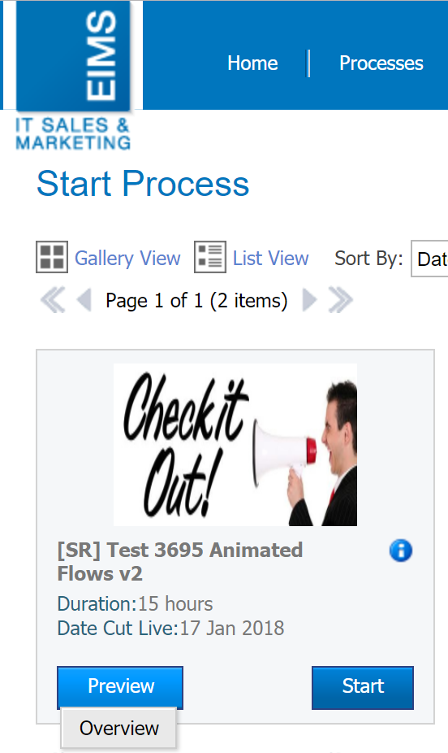
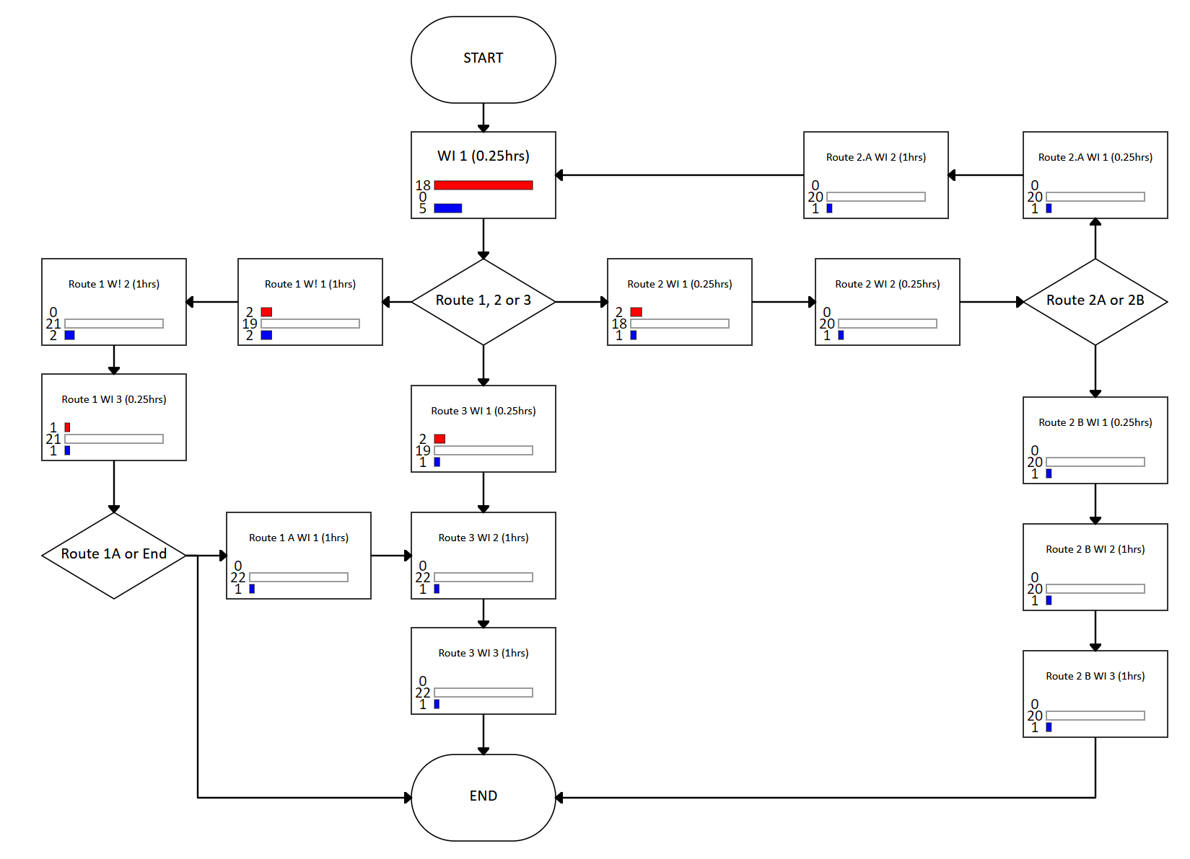
How to view animations in the Web Platform
Click on the Overview button in the Start Process Page in WMS
The overview page will load for the process version
Once a WorkItem has been completed or a process has been instantiated an animation will trigger - meaning a bubble will go from A to B!

Slide 5
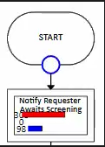
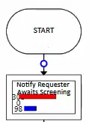
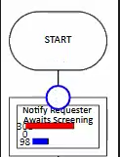
Animation Bubble
When the animation bubble begins to travel from Shape A to Shape B it starts off as a big bubble
While the bubble is travelling down the connector it becomes smaller
Once the bubble reaches Shape B it becomes big again and disappears because the Shape is now active
Animation Bubble is big at the end of Shape A
Animation bubble becomes small while travelling down a connector
Animation bubble becomes big again once Shape B has been reached

Slide 6
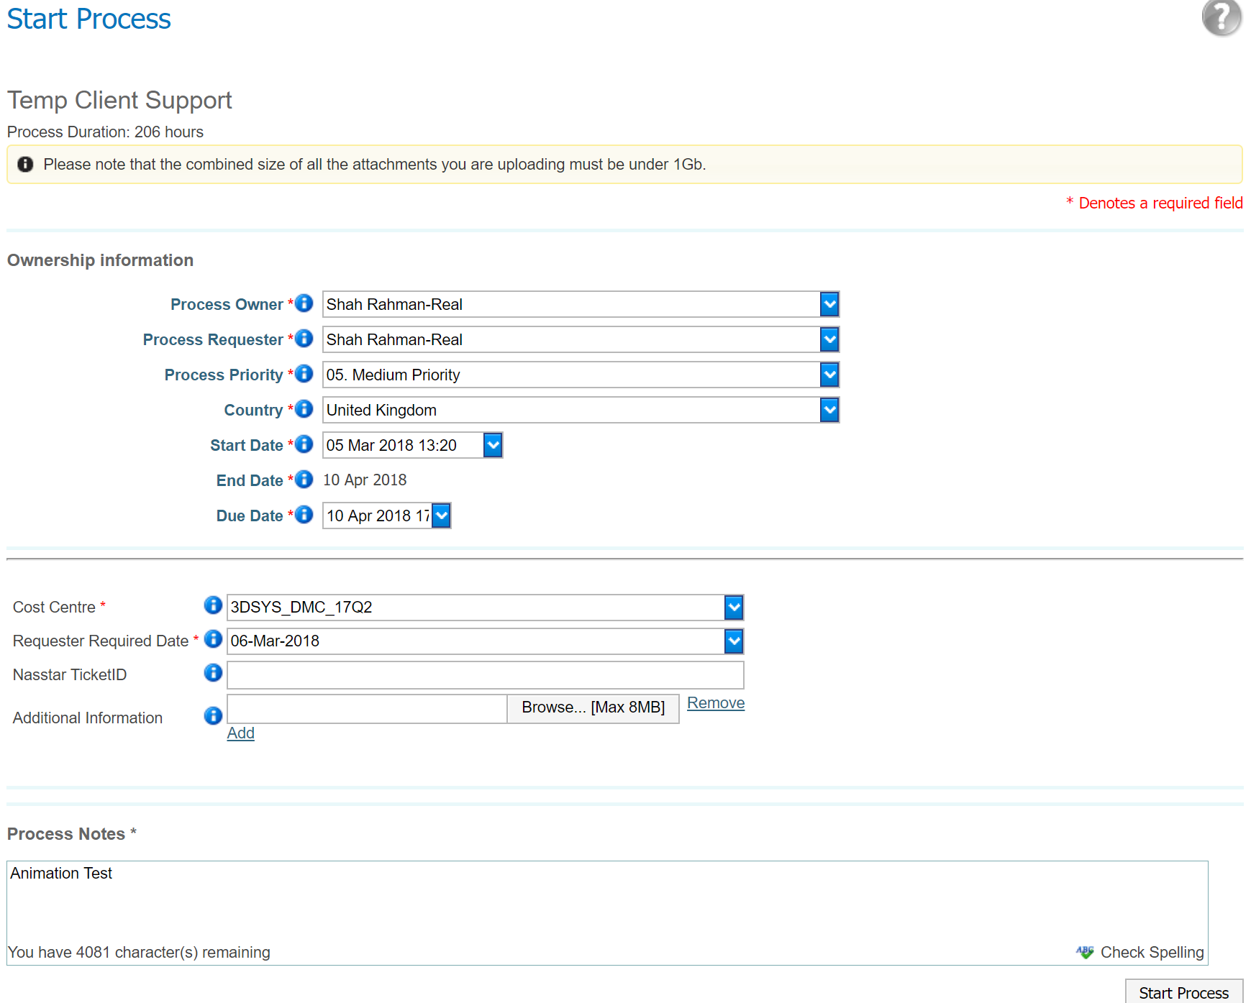
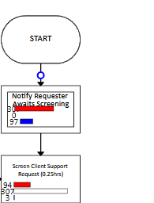
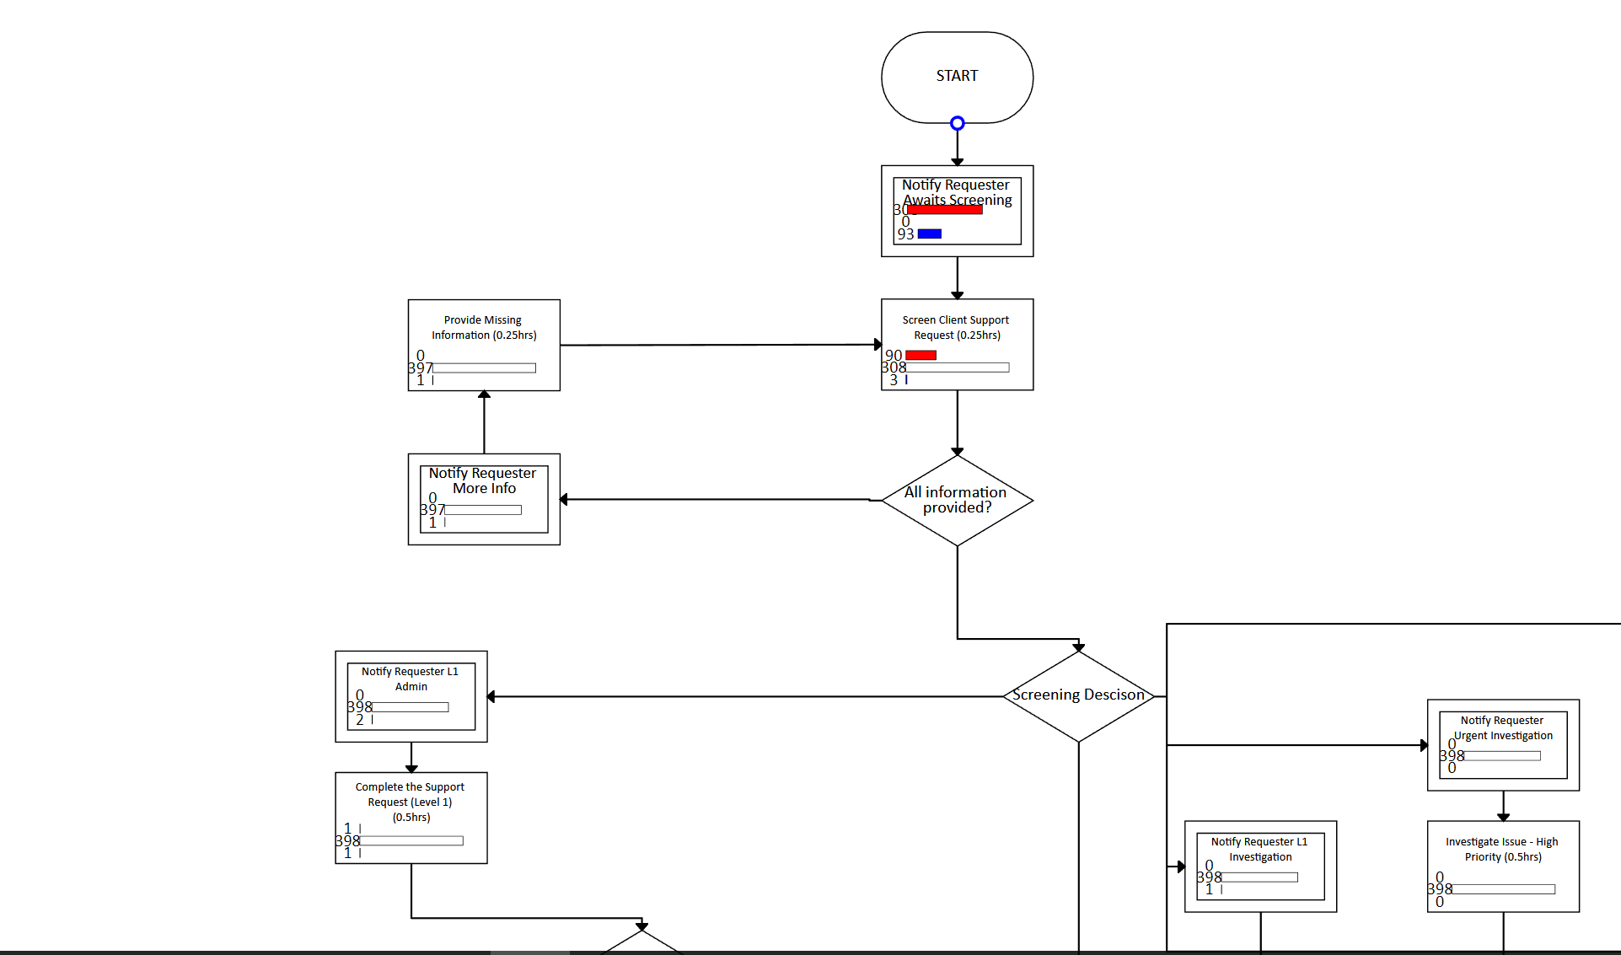
How animations work in the Web Platform
When a process is started
The animation bubble will go from the Start WorkItem to the next WorkItem shape in the process diagram
Or when other WorkItem shapes have been completed (Standard, Timer, Automated or Sub Process)
The animation bubble will go from the completed WorkItem shape to the next WorkItem shape
Animation occurs from the Automated to the Standard WorkItem
Animation bubble travels from Start to the next WorkItem
Bubble travels down the connector to the next WorkItem shape

Slide 7
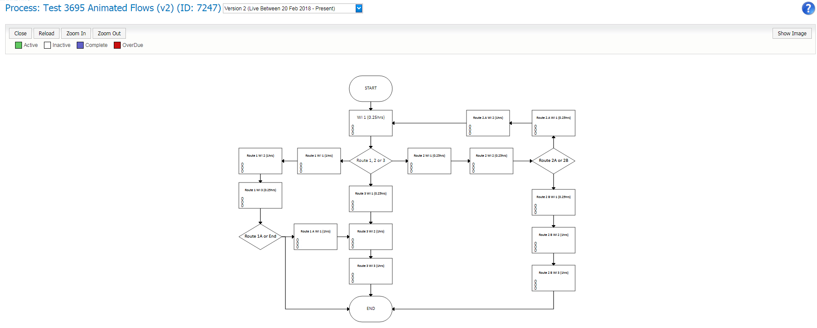
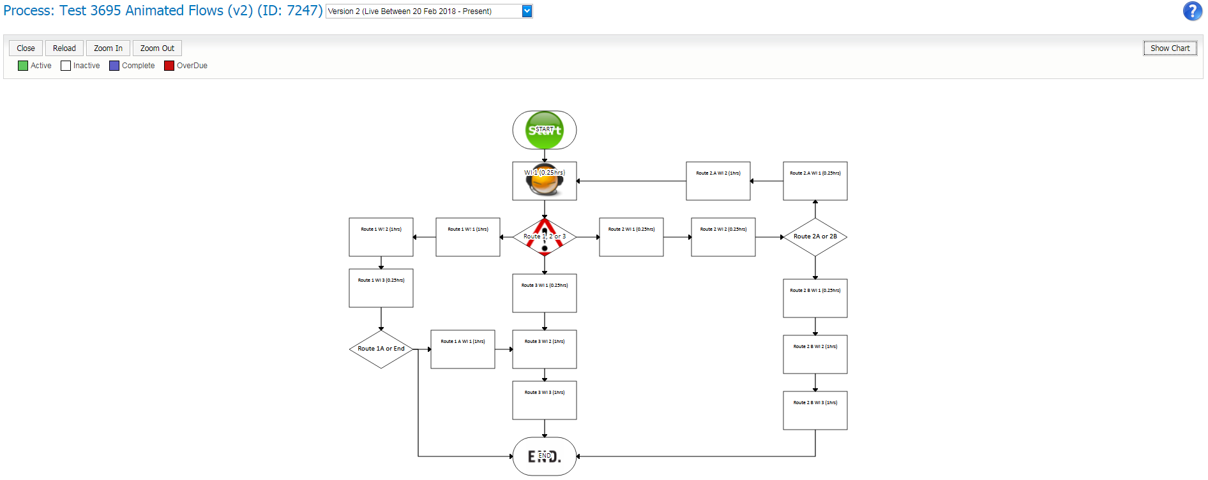
Images for WorkItems in the Overview page
We are also able to view images for WorkItems in the Preview Mode and in Overview.
See the Appendix to see how to set up images for WorkItems
When ‘Show Image’ is selected, images are displayed with no counts
When ‘Show Chart’ is selected counts of WorkItems are displayed
By default the chart view will load (with counts of WorkItems for processes instanced)
Click on ‘Show Image’ to change the view
Page will refresh & images will display
Click on ‘Show Chart’ to change the view
When images are displayed no counts of WorkItems are displayed

Slide 8
Now lets show you an example…

Slide 9
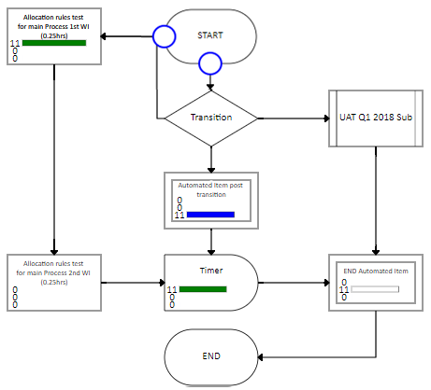
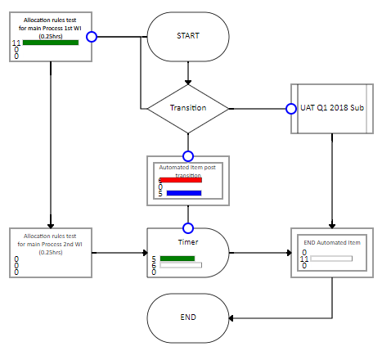
Small example of animation
We bulk imported 11 processes
As these processes were generated in the system the counts for the first WorkItem shape were updated (11)
In this example the transition answer is in the Start WorkItem, so once the Start WorkItem is completed the transition animation bubbles will show the path followed
Counts update with the animations
Animations occur based on answer to route
Counts update with the animations
This animation is also happening at the same time because one of the automated items has completed too

Slide 10
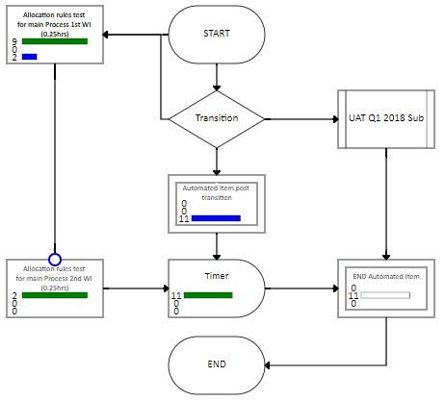
Small example of animation
We have completed the first WorkItem Shape in some of the processes
The Animation shows the path followed for these completed WorkItems
Which is only 1 path
The counts have also been updated for the Completed and Active WorkItems
This WorkItem has been completed so the animation has been triggered
Counts update with the animations

Slide 11
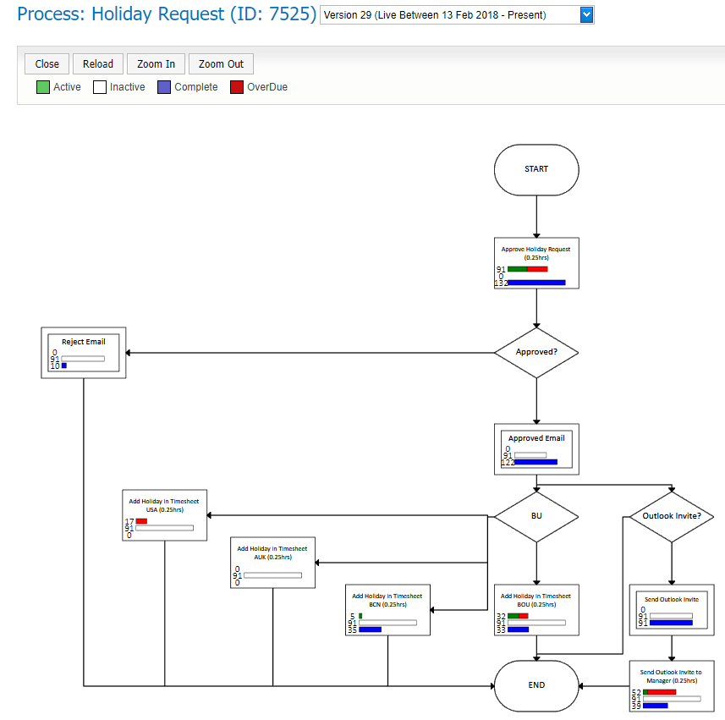
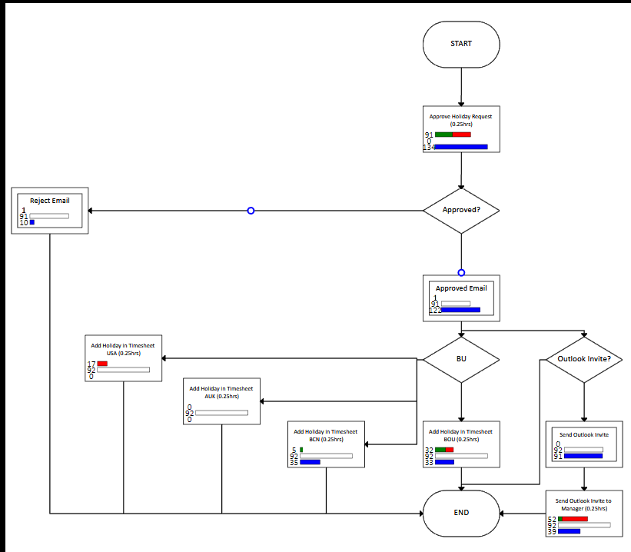
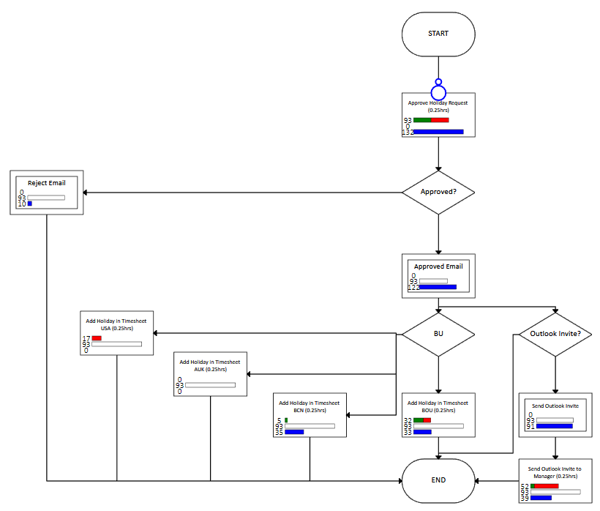
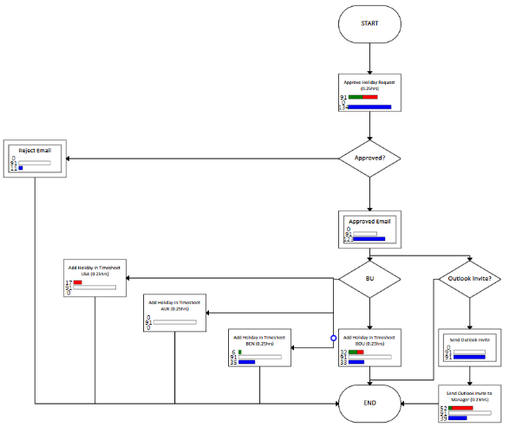
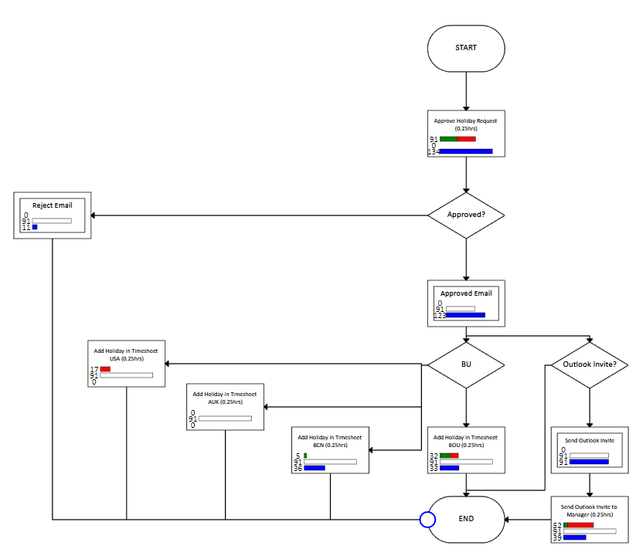
Here’s an example you will be very familiar with…
One of the holiday requests has been rejected while the other has been approved
I have instanced two holiday requests
One of the holiday requests has been rejected while the other has been approved
I am going to start the holiday request process
2
3
1
The approved holiday request has moved onto the next WorkItem in the process
4
5
The WorkItem has been completed and the process has gone to end

Slide 12
What to expect in larger processes

Slide 13
Larger process animation
Here we are triggering animation for a larger process
We have bulk imported 5 instances of the process
As these were generated in the system the counts for the first WorkItem shape were updated to 5
Animation occurs from the Start WorkItem Shape to the next WorkItem Shape
Total of 5 processes created
Counts update with the animations

Slide 14
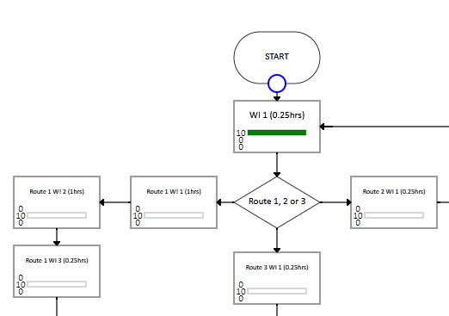
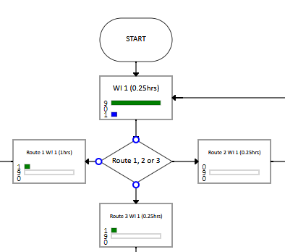
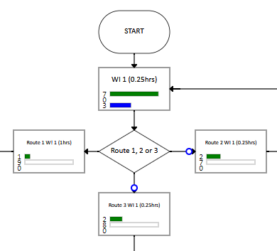
Larger process animation
Total of 10 processes created
Then we bulk imported another 5 processes & completed some of the first WorkItems
The Animation shows the path followed for these completed WorkItems
Based on the answer to the route in the first WorkItem (WI 1) the process can go down different paths in the process.
The counts have also been updated for the Completed and Active WorkItems
Note: In a process simultaneous animations can happen as the design can have multiple Active WorkItems at the same time
1
Animations occur based on the answer to route
2
2
Counts update with the animations
Animations occur based on the answer to route

Slide 15
Appendix How to set up WorkItem Images

Slide 16
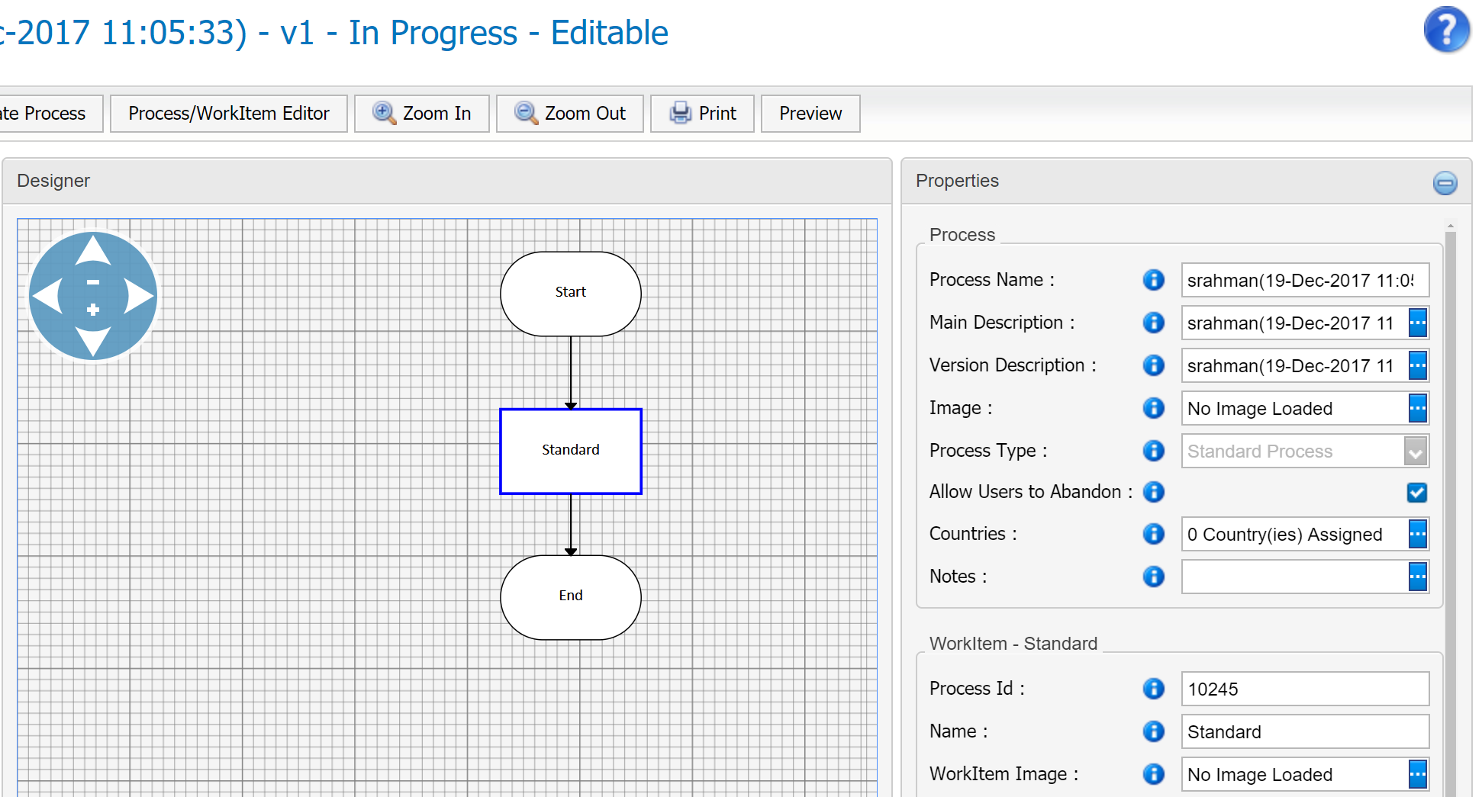
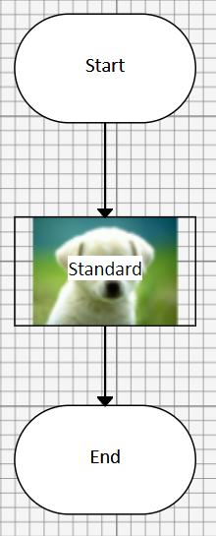
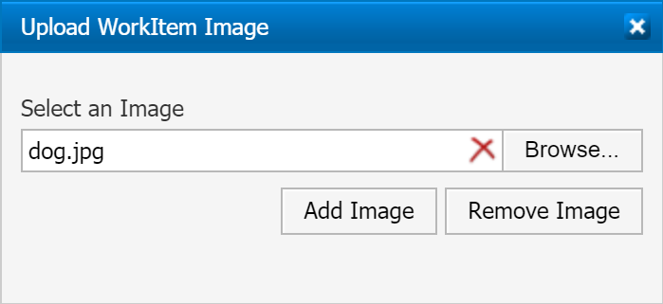
Setting up Images for any WorkItem shape
In Process Designer, you are able to set up images for any WorkItem shape
When a WorkItem is selected, you will see WorkItem Image in the properties section
When the ellipsis is clicked on a pop up will appear asking you to browse and upload an image
Once the image has been added it will appear on the WorkItem

Slide 17
Thank you for your time! END

